Slide 1

Stroke mortality risk factors from population health and socioeconomic perspective in the USA
Nassim Rahimi, PhD
November 15, 2017

Slide 2


Motivation & Background
Why this study is important?
Stroke risk factors have been studies extensively from medicine and pharmaceutical perspective. In this work we look at this issue from lifestyle and socioeconomic perspective.
Why Stroke among other mortal incidents?
Stroke is the third leading cause of death in the US with annual mortality rate of 140,000 people. In additional to devastating impact on families
Stroke is the main cause of serious, long-term disability in the US leading to huge financial burden for the society.
Each year, approximately 795,000 people suffer a stroke of which about 600,000 are first attacks
Data Sources
Three publically available datasets were collected for this study
Stroke mortality rate among US adults dataset was collected from healthdata.gov
The lifestyle dataset was collected from catalog.data.gov which contains data on adult's diet, physical activity, and weight status from Behavioral Risk Factor Surveillance System
Unemployment and median household income for U.S. states and counties from USDA.gov
Analytical Goals
Visual exploring the stroke mortality rate as well as each of the lifestyle factors on a map
Investigating state-wise correlation between each of those factors and the mortality rate
Notes:
. Unknown interesting patterns might emerge when multiple datasets are combined

Slide 3

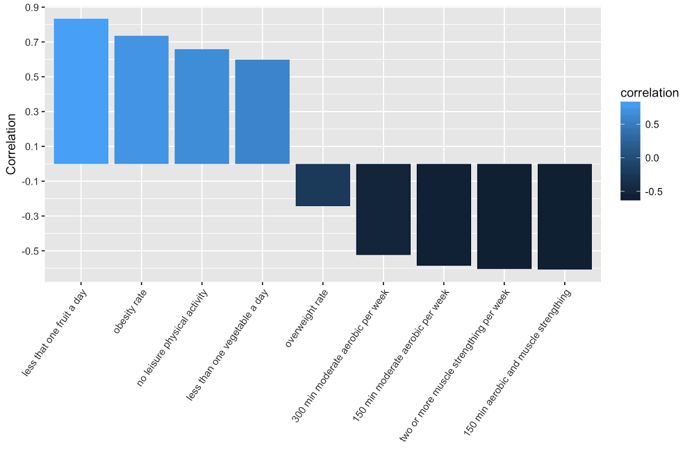
Findings & Impact by state
Strong regional correlation impacting southern states (Alabama, Mississippi, Louisiana and Arkansas) the most. In contrast, New England region enjoys the lowest stroke mortality rate
The top correlated lifestyle factor with stroke mortality rate is surprisingly low consumption of fruits (correlation of 0.83) even more than obesity (0.73)
combination of moderate aerobic activity and muscle strengthening exercises are more helpful compared to either of the two
while obesity shows a high correlation with stroke mortality (0.73), overweight status is negatively correlation (-0.24).
Notes:
Limitations and Next Steps:
Despite the interesting results, the current study has number of limitations. Many other factors such as income, education, ethnicity and even climate should be considered as well. Also, multivariate methods might be helpful in identifying the risk factors as many of them might be highly correlated. Lastly, the results should be more geographically granular (zip code or county) in order to be useful in large states such as California and Texas.

Slide 4
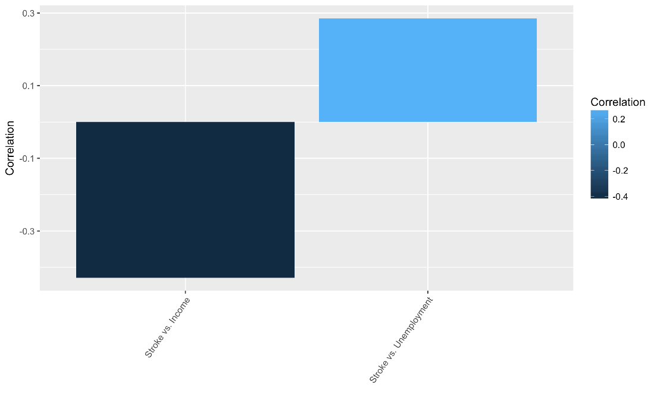
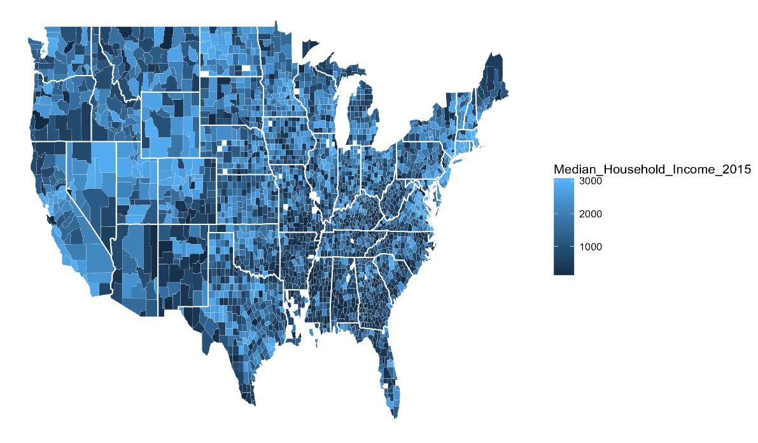
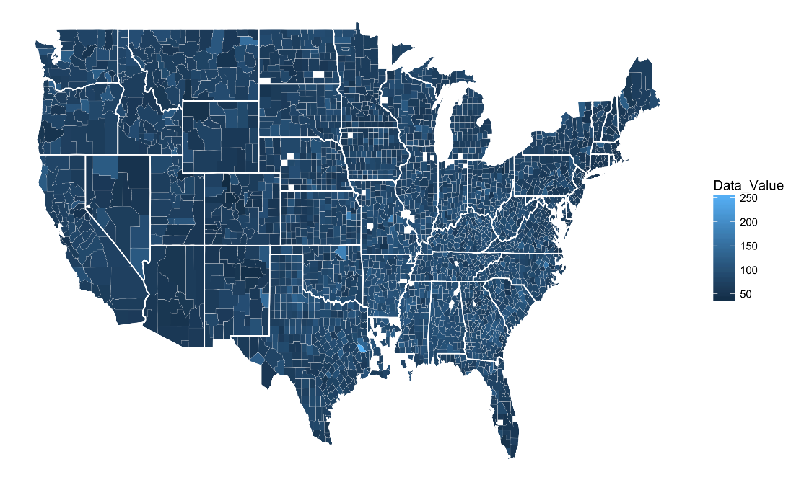
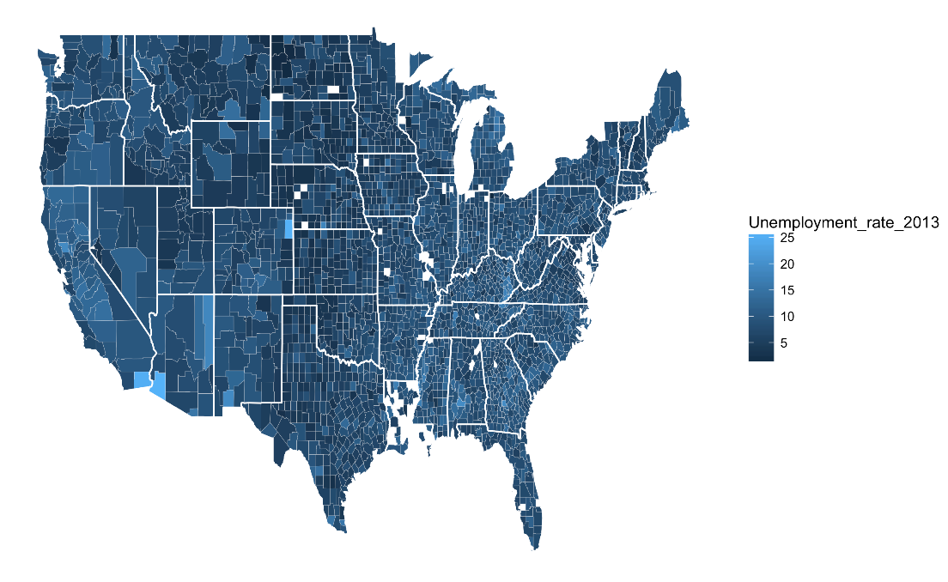
Findings & Impact by Counties
Unemployment increases the stroke rate and wealth will do otherwise
Notes:
Impact:
The results of such study can be used in federal and statewide healthcare budget and initiatives to target top risk factors in each state. An example would be subsidizing fresh fruits in specific schools and communities. Moreover, the results can be used to direct healthcare advertisement and education in each state.

Slide 5


